Slide 1
Is it Time for a Standardized API?
MH10.8 Meeting
Detroit, MI
20 April 2010
Larry Huseby
Intermec

Slide 2
Ad Hoc chartered to discuss scope
Don Ertel don.ertel@cdotech.com
Jeff Hunt jeff.hunt@intermec.com
Jeff Sailors jeff.sailors@intermec.com
Heather Weier heather.weier@ngc.com
Sprague Ackley hsackley@cs.com

Slide 3
First evaluate Scanner Control
All vendors support call or calls to a scanner
Upper level code can be anything (e.g. JAVA)
Lower level code is vendor specific (e.g. device driver or service layer)
Intermediate layer causes the upper layer to “talk” to the lower layer

Slide 4
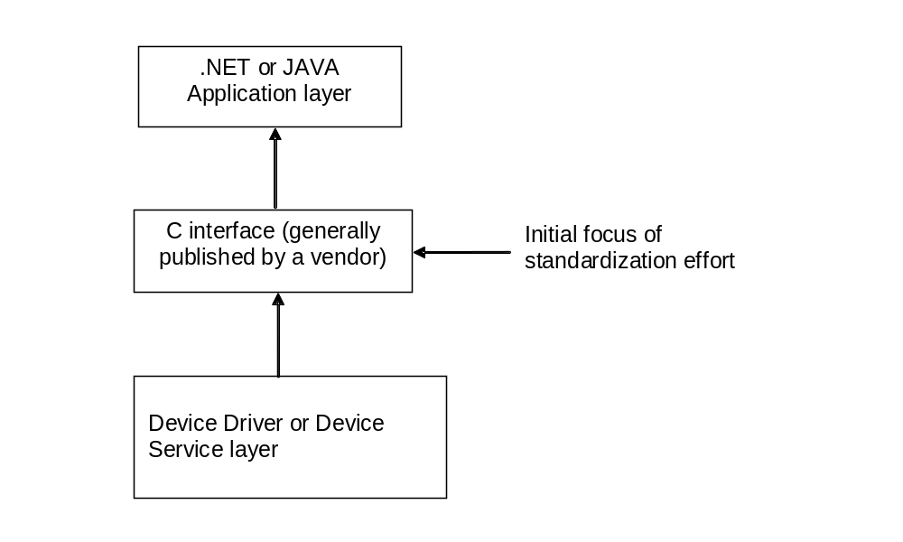
Proposed standard to focus on the intermediate layer

Slide 5
Good news - Bad news
C - interface is fairly common
Operating philosophy can be completely different between vendors
For example: Motorola provides a windows event message and Intermec provides a blocking read that must be called on a separate thread to wait for data available.

Slide 6
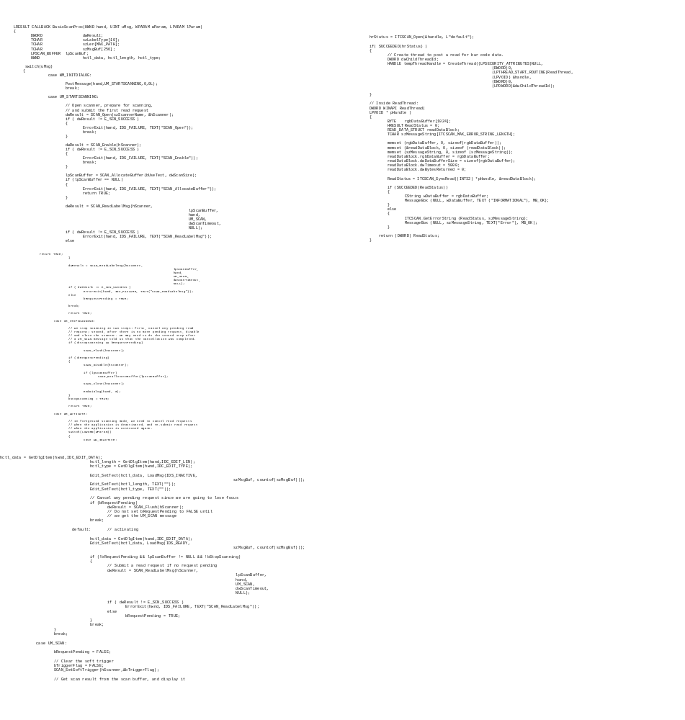
Comparing Motorola to Intermec for enabling scanner and getting data read

Slide 7
Standardized interface
Pick one of the philosophies?
Include all philosophies?
For example: Motorola used MS Windows constructs, Intermec’s is supportable by multiple OSs
Note: This analysis only compares two manufacturers

Slide 8
Other support
Even is a standardized API is developed ...
  Development tools
  Training
  Customer support functions

Slide 9
Project requirements
Substantial user support required
  At least two major customers need to provide full-time support to the committee
Substantial vendor support required
  At least two major vendors need to provide full-time support to the committee
Several multi-day face to face meetings with highly technical, C-code writing sessions as well as much homework between sessions
The project will likely take two years

Slide 10
"Those who cannot remember the past are condemned to repeat it."
George Santayana1863-1952
Approximately ten years ago a similar effort led by Microsoft failed in its attempt to do the same thing

Slide 11
Is it Time for a Standardized API?
MH10.8 Meeting
Detroit, MI
20 April 2010
Larry Huseby
Intermec

